Slide 1
Multinational Bank Customer Churn
T4: Analytical Avengers
Brunda Mariswamy, Alice Pascalev, Akhil Bharadwaj, Bharath Reddy Duvvi

Slide 2
About Customer Churn
Customer Churn prediction means knowing which customers are likely to leave or unsubscribe from the banking service. For many companies, this is an important prediction.
Identifying customers at risk of churn → we need to know exactly what marketing efforts we should make with each customer to maximize their likelihood of staying.
Notes:
Customer churn, also known as customer turnover, occurs when a customer chooses to leave or unsubscribe from a service for any reason. In the context of this project, we are looking at customer churn in banking. Being able to predict customer churn is important because we want to retain as many customers as we can. The idea behind this that (of course you want to keep customers), but also it is cheaper to retain your customers, than having to spend money to acquire new customers to replace the ones that left. Lower customer acquisition costs = more profits. By identifying customers at risk of churn, we are able to identify which efforts in order to maximize their likelihood of staying.

Slide 3
Goal: Identify the variables which have the highest correlation and dependence with churn, across countries and cultures.
Rationale: The variables identified can then be used to inform banks of what customer activity, trends, and attributes should be monitored so the bank can make efforts to retain the customers before the account has been closed.
Notes:
In our research, we aim, through EDA, to identify the variables which have the highest correlation with churn, across countries and cultures. The variables identified can then be used to inform banks of what customer activity trends and attributes should be monitored so the bank can make efforts to retain the customers before the account has been closed.

Slide 4
About the Data Set
customer_id Customer ID
credit_score Credit Score
Country
Gender
Age
Tenure (time with bank)
Balance
products_number Number of Banking Products
credit_card Credit Card
active Active member
Estimated_salary Estimated salary
Churn
Data from ABC Multinational Bank, an anonymized data set including customer attributes and their respective banking behaviors.
Source: Bank Customer Churn Data Set Kaggle
10,000 observations of 12 variables

Slide 5
Preparing for EDA
Dropped 1 variable: customer_id
Checked for null values: none found
Converted the following variables into categorical
credit card, active member, churn, gender
Checked for & removed outliers
Checked continuous variables: credit score, age, tenure, balance, est. salary
Removed: age, credit score

Slide 6
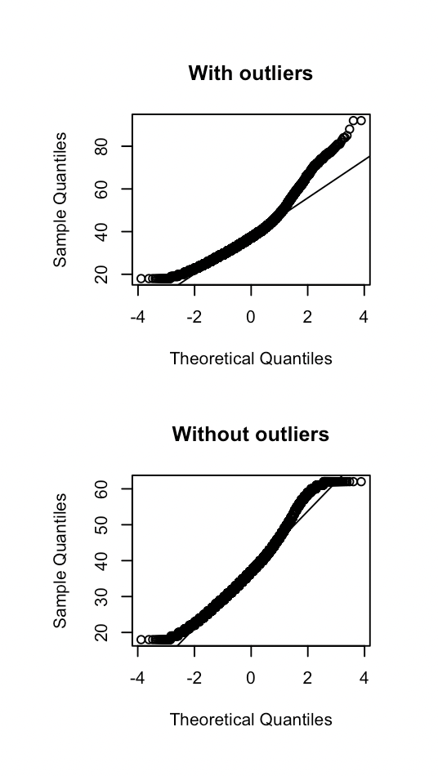
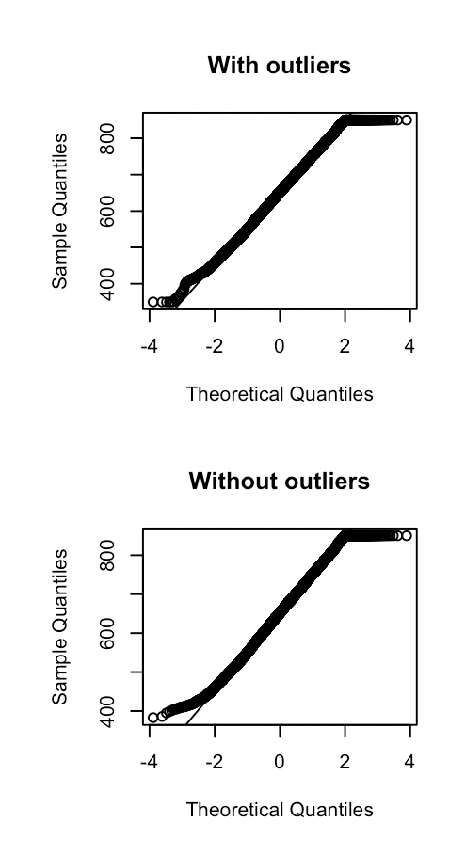
Credit Score
Age
Outliers were found only in age and credit_score variables
Age: 3.7%
Credit Score: 0.2%
Notes:
By using outlierKD function we can observe that outliers where found only in age and credit_card variables i.e,3.7% and 0.2%. Other variables balance, tenure, salary were 0

Slide 7
Customer Analysis

Slide 8
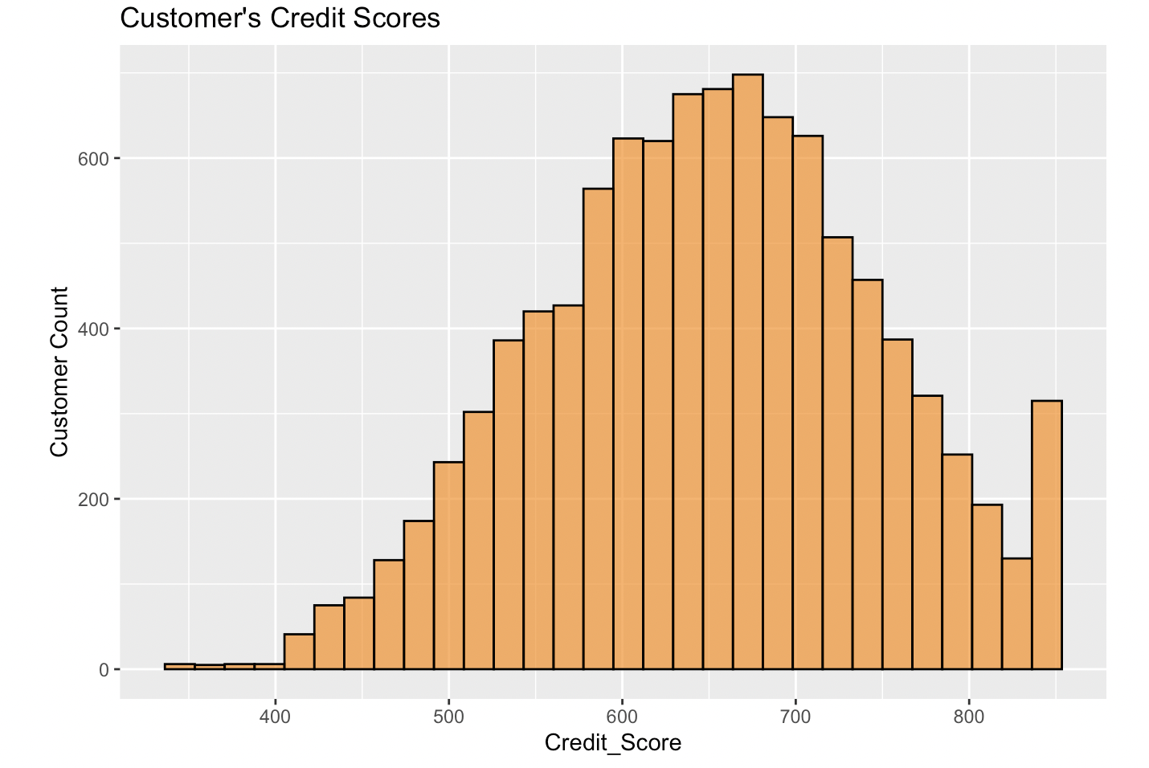
Credit
Scores
The average credit score of the customer is 650.529
SD 96.653
Notes:
The average credit score of the customer is 650.529, most of the customer having credit score fall between 600 to 700 and standard deviation is 96.653.

Slide 9
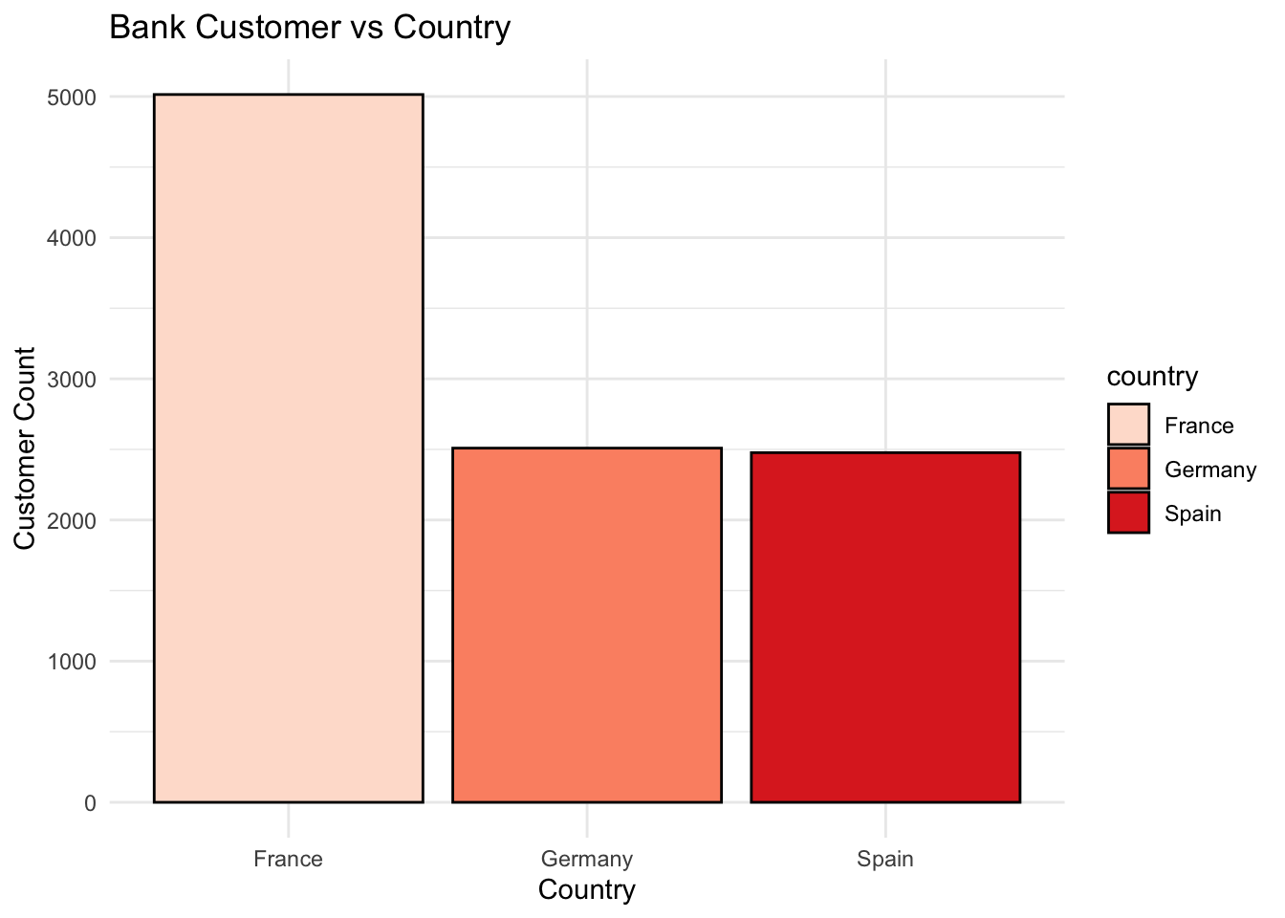
Country
More than 50% of ABC Multinational Bank’s accounts are based in France
Notes:
The customers are grouped by the countries in which they have their accounts. As we see from the plot France has more than 50% of customer account which is the highest among all other countries.

Slide 10
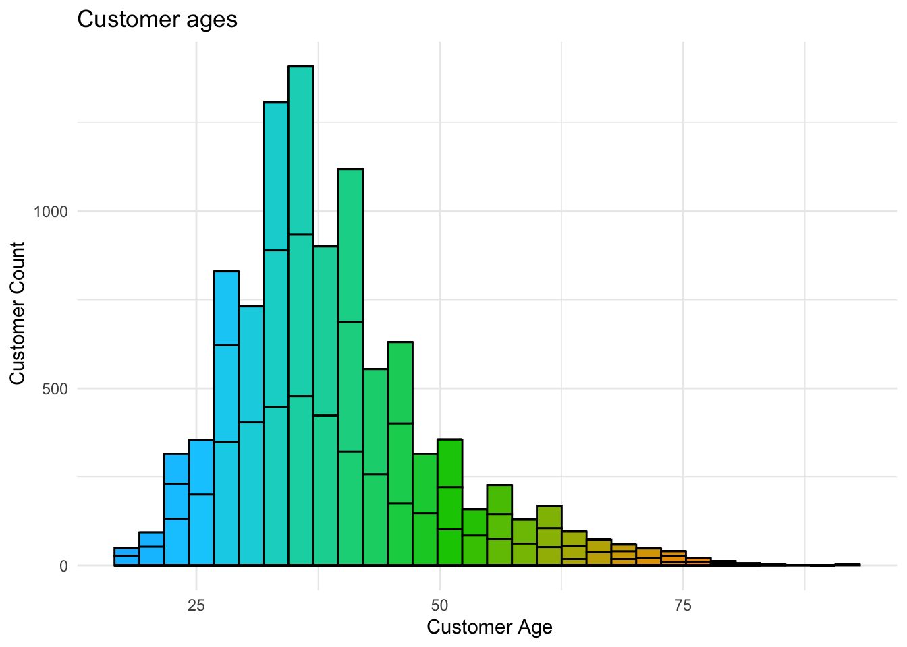
Age
The majority of the bank customers fall under the age of 50 with average age of 38.922
Notes:
The majority of the bank customer’s fall below the age of 50 with average age of 38.922 and with standard deviation of 10.488.

Slide 11
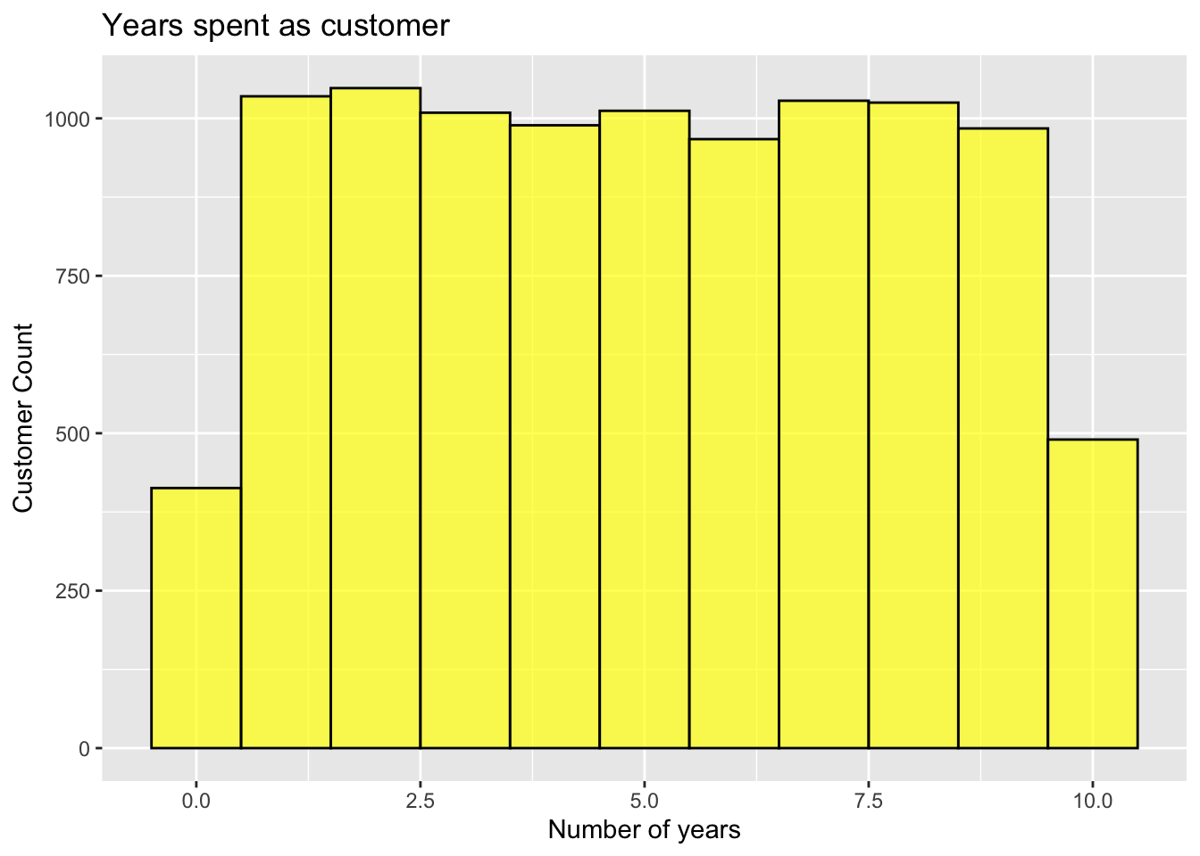
Tenure
Notes:
Most of the customer as been with bank for more than a year.

Slide 12
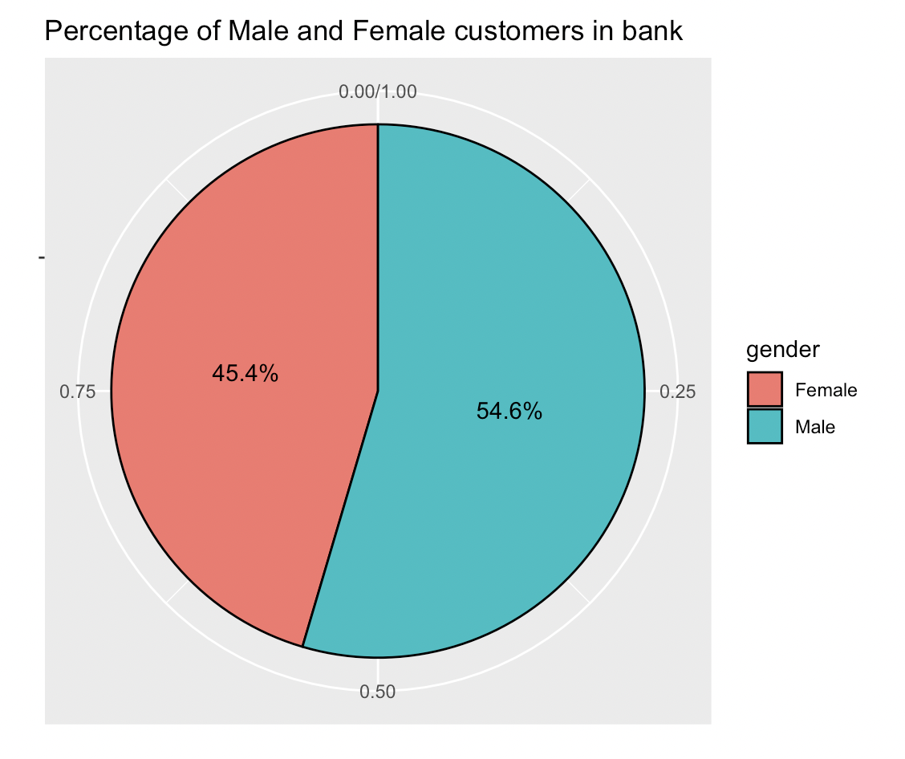
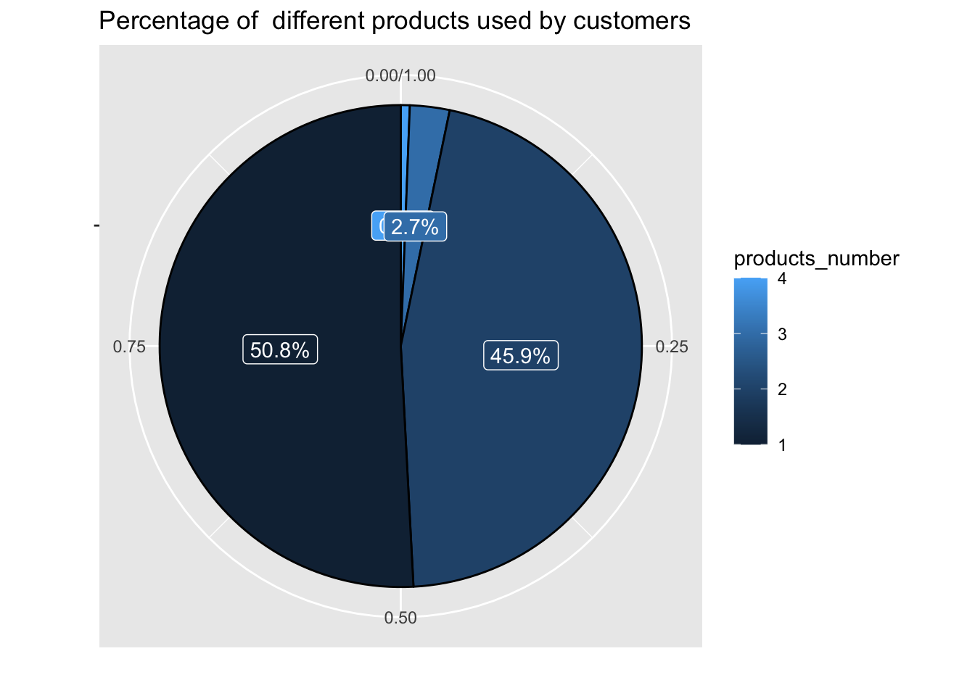
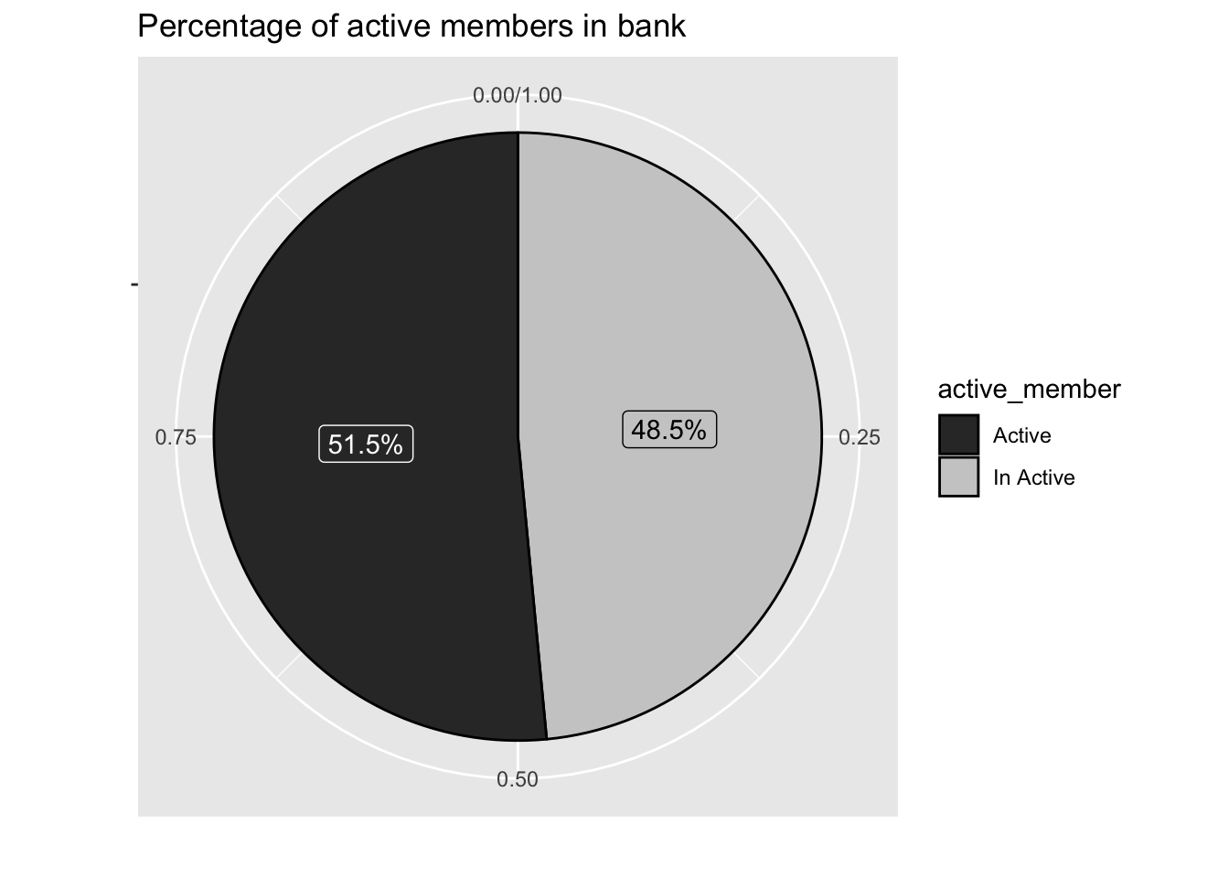
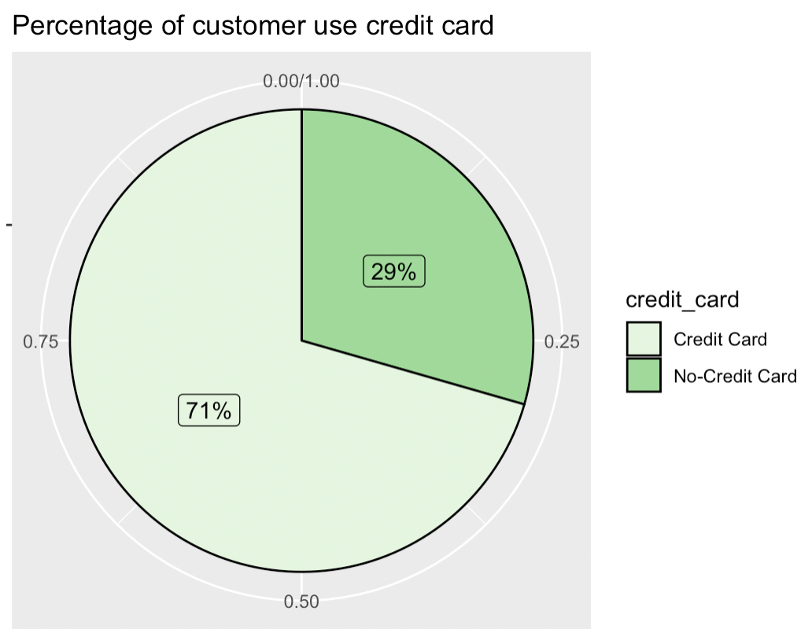
Notes:
Gender -
Products Used - We can see that 48% of the customers accounts are inactive
Active Members -

Slide 13
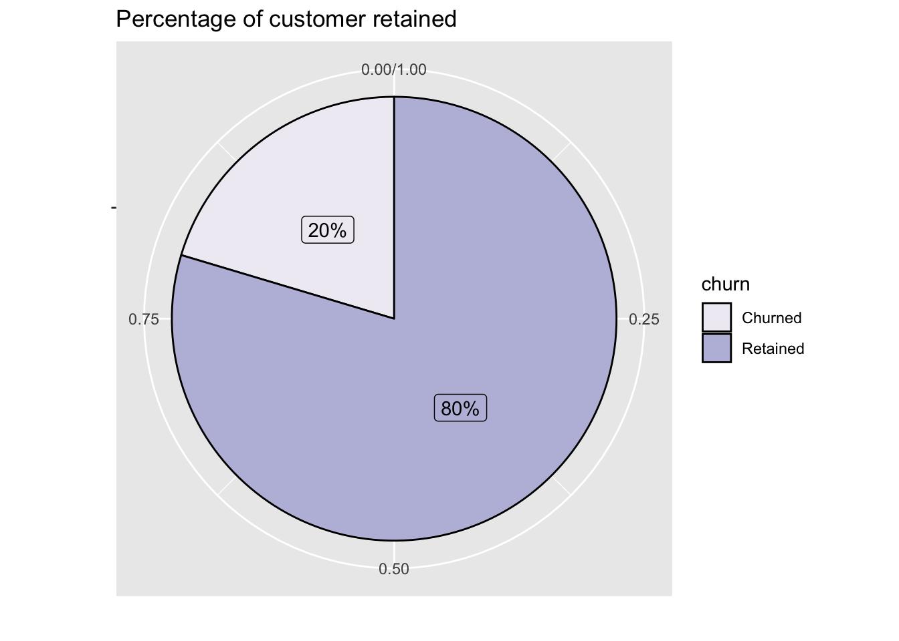
Churn rate

Slide 14
S.M.A.R.T. Questions

Slide 15
The big question:
What factors affect the Customer Churn Rate in Multinational banks?

Slide 16
Does churn depend on Gender?
Does the account holder’s age have an influence on churn?
Does churn depend on status of active account users?
Does churn depend on different banking product and services provided by the banks?
Does a higher/lower credit score of the customer affect churn?
Does a higher/lower estimated salary of the customer affect churn?
Does a higher/lower account balance of the customer affect churn?
Does a user having a credit card with the bank affect their predisposition to churn?
Does the churn rate depend upon which country the customer belongs to?

Slide 17
Does churn depend on gender?
Chi Square Test for independence
H0: Customer’s gender and churn are independent
H1: Customer’s gender and churn are not independent

Slide 18
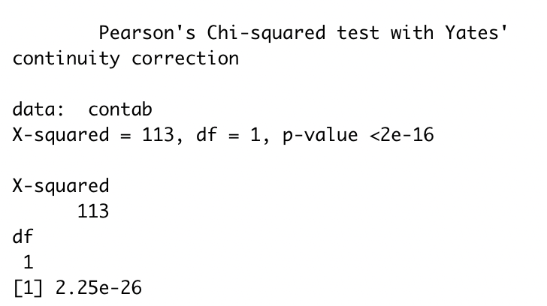
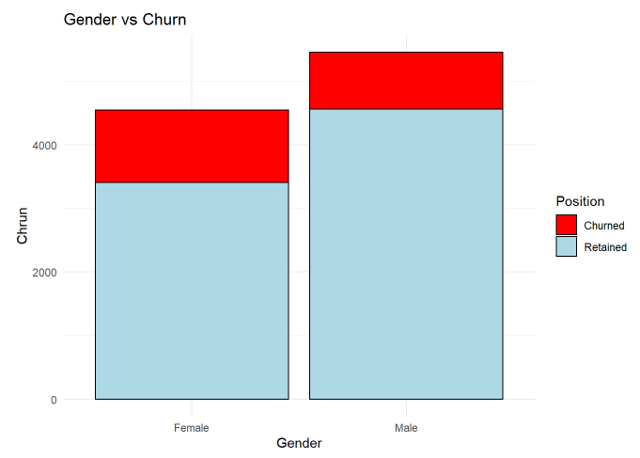
Count->Male 54.6%
Female 45.4%
P value less than significance level of (0.05) ,
Hence we reject the null hypothesis(H0).
We conclude that the churn rate is dependent on gender the customer.
25.07% of Female churn rate
16.45% of Male churn rate

Slide 19
Does churn depend on account balance?
Correlation test between account balance and churn

Slide 20
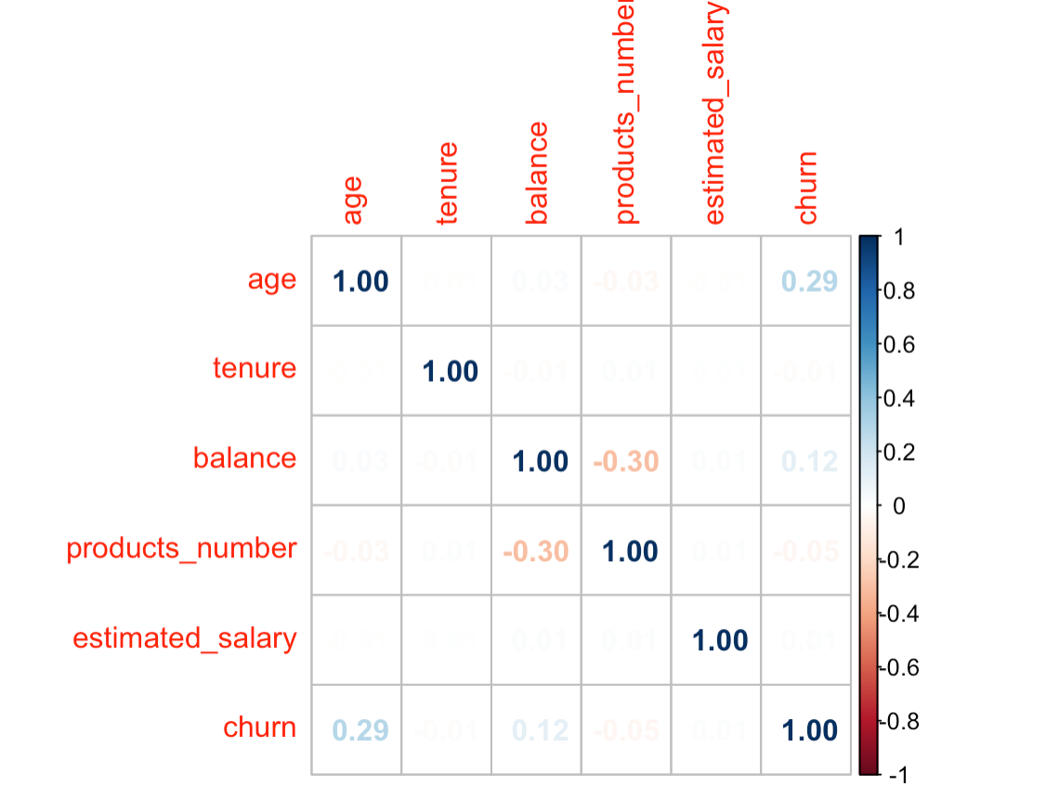
Correlation between account balance vs churn
Customer churn is weakly correlated with account balance with a score of 0.12
For further analysis we can check the correlation score by combining multiple variables
Notes:
Churn & Balance are weakly correlated (Positive) - 0.12.

Slide 21
Does the account holder’s age group affect churn?
Correlation test between age and churn

Slide 22
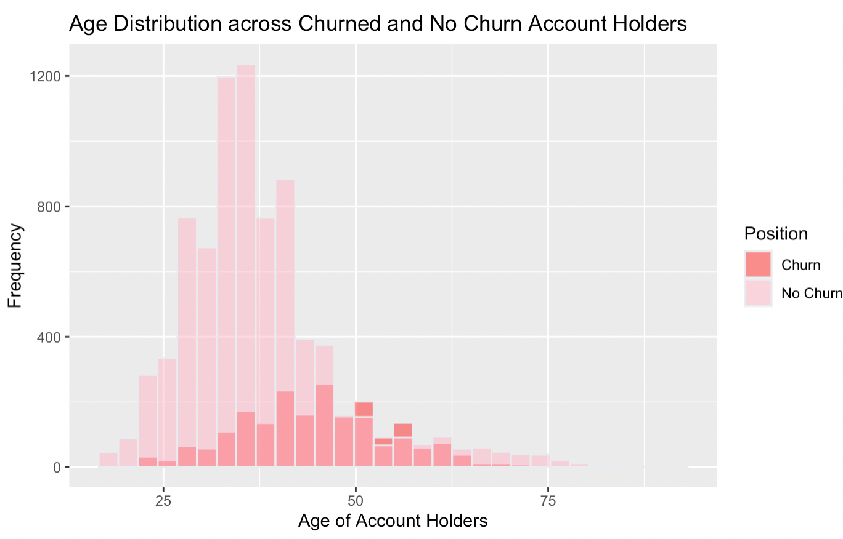
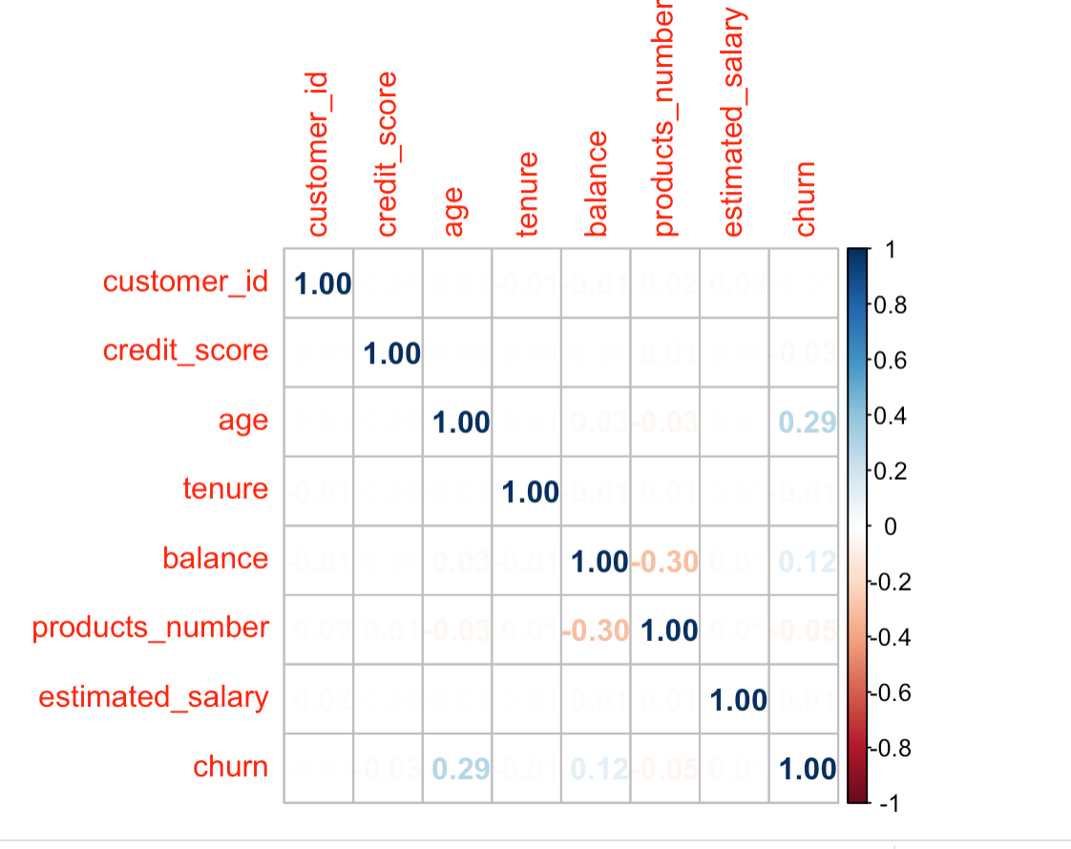
Customer churn is weakly correlated with customers age with a score of 0.29
Notes:
Churn & Age are about to moderately correlated (Positive) - 0.29.

Slide 23
Does churn depend on status of active accounts?
Chi Square Test for independence
H0: Customer’s active status and churn are independent
H1: Customer’s active status and churn are not independent

Slide 24
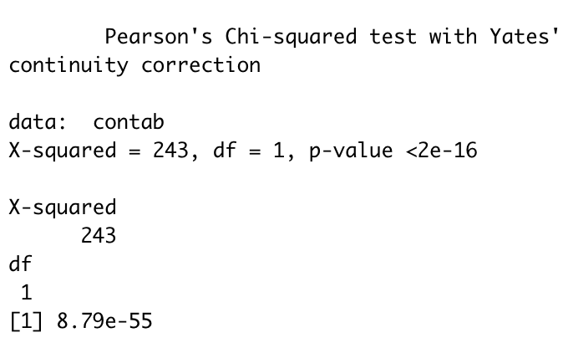
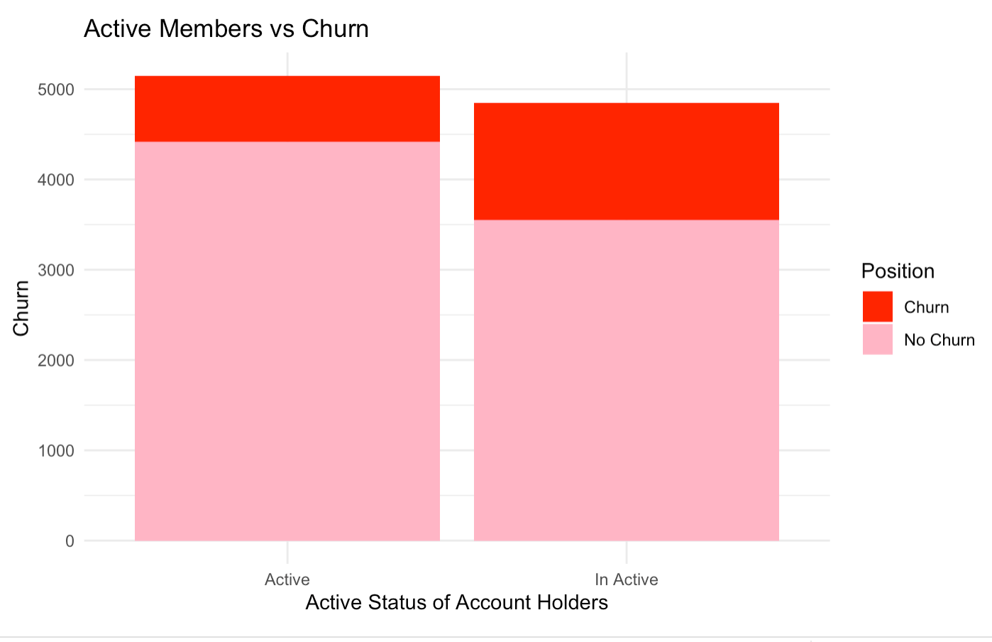
P- value is way less than the significance level (0.05)
Reject the null hypothesis (H0).
The data is strong enough to conclude that the active status and the customer churn are not independent.

Slide 25
Does churn depend on different banking product and services provided?
Chi Square Test for independence
H0: Banking products, services and churn are independent
H1: Banking products, services and churn are not independent

Slide 26
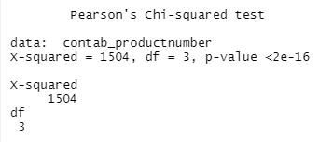
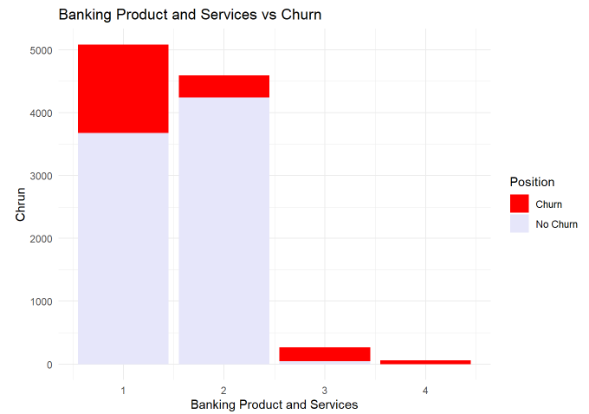
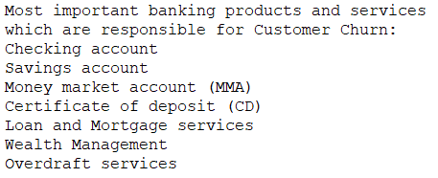
Notes:
The possible interpretation is that the more products the customer has, the more engaged with the bank he is. As the institution has a high value for the customer, the cost of leaving the institution may be higher from the customer’s viewpoint. Strengthening the relationship through increased quantity and use of products and services can improve customer satisfaction and increase the cost of change, thereby contributing to customer retention.

Slide 27
Does churn depend on credit score?
Correlation test between credit score and churn

Slide 28
Customer churn is weakly correlated with credit score with a score of -0.0271.
For further analysis we can check the correlation score by combining multiple variables
(-0.0271)

Slide 29
Does a user having a credit card with the bank affect predisposition to churn?
Chi Square Test for independence
H0: Having a credit card and churn are independent
H1: Having a credit card and churn are not independent

Slide 30
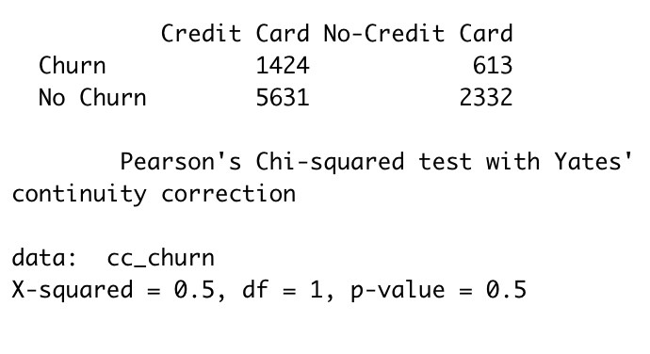
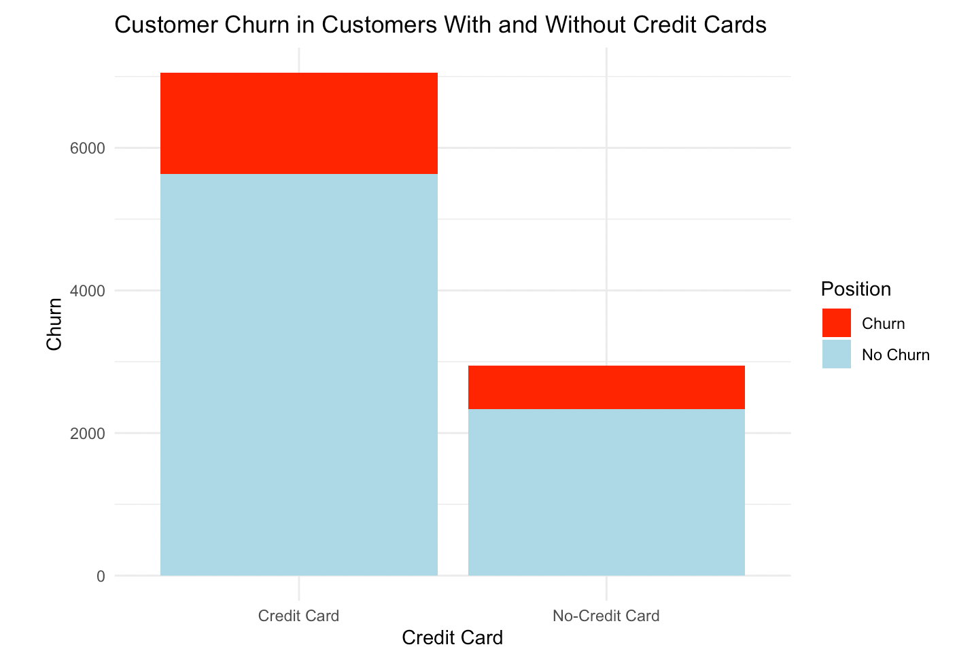
P-value =0.5 > 0.05 (df=1)
Can not reject the null hypothesis (H0), as there is a 0.5 or 50% chance of these results occurring by chance.
No statistically significant relationship between a user having a credit card with the bank, and churn.
Notes:
P-value of 0.5 is much higher that the significance level (0.05 for df=1). Thus, we do NOT reject the null hypothesis, as there is a 0.5 or 50% chance of these results occurring by chance. We can conclude that there is no statistically significant relationship between a user having a credit card with the bank, and churn.

Slide 31
Does churn rate depend on which country the user banks in?
Chi Square Test for independence
H0: Country and churn are independent
H1: Country and churn are not independent

Slide 32
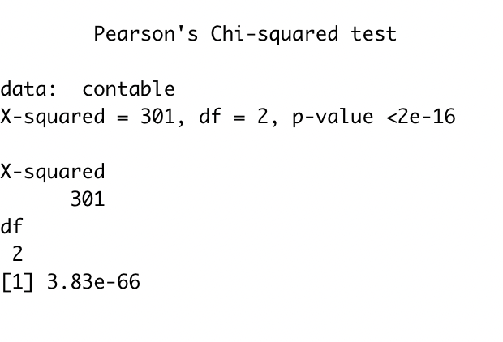
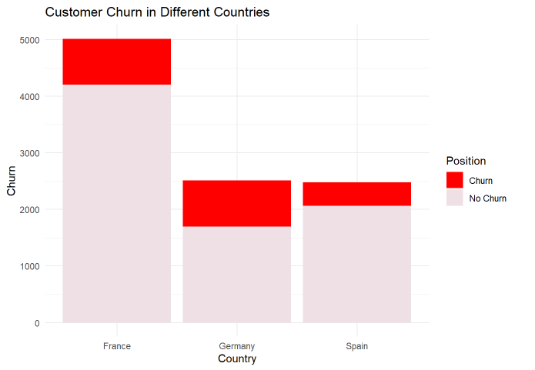
P- value is way less than the significance level (0.05)
Reject the null hypothesis (H0).
The data is strong enough to conclude that the country that the customer belongs to and the customer churn are not independent.
Notes:
P- value is way less than the significance level (0.05) which means that we reject the null hypothesis (H0). The data is strong enough to conclude that the country that the customer belongs to and the customer churn are not independent.

Slide 33
Summary
Churn is weakly correlated with:
Account balance (0.12)
Credit score (-0.0271)
Age (0.285), with churned customers having a higher average age
Female account holders have a larger tendency to churn, as opposed to their male counterparts (25.07% of Female churn rate 16.45% of Male churn rate)
Churn is dependent on account activity status - (14.26% of Active churn, 26.85% of Inactive accounts churn).
Churn is dependent on country - Customer churn rate is maximum for Germany at 32.4% while for France and Spain it is at 16.2% and 16.7% respectively).
No statistically significant correlation:
Credit card holders and churn

Slide 34
Questions?

